Slide 1

Intro to AI
part2

Slide 2
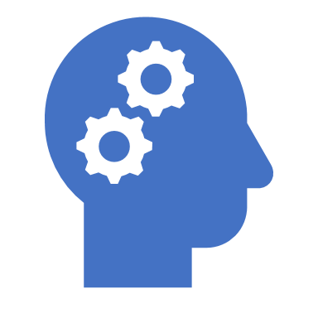
Recap what we have learnt earlier
Introduction (What is AI, history, The value of AI, and ANI vs AGI).
ML (Definitions, types of ML, what makes AI so powerful recently?).
Supervised (Examples, how most of AI problems is around it).
Un-supervised (why it's needed, and problem it solves in the real world).
Data (how it worth?, types of data, its resources, Use and misuse of data, data is messy).
Data Science

Slide 3
Agenda
Deep Learning (intro, history, why it’s needed over ML, and its applications).
AI and related disciplines.
RL (Intro, how it's important to achieve AGI, examples).
Computer vision.
NLP ( intro, it's examples in the real world).
What ML can and can’t do? (examples, strengths, and weaknesses of ML).
What makes you a good data scientist?

Slide 4
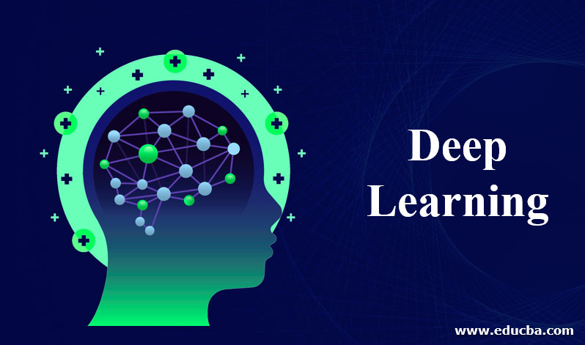
Intro to Deep Learning (DL)
At a very basic level, deep learning is a machine learning technique that teaches a computer to filter inputs.
Deep learning is inspired by the way that the human brain filters information!
Essentially, deep learning is a part of the machine learning family that’s based on learning data representations (rather than task-specific algorithms).
DL closely related to a class of theories about brain development proposed by cognitive neuroscientists in the early ’90s.
In the human brain, there are about 100 billion neurons, and each neuron is connected to about 100,000 of its neighbors. Essentially, that is what we’re trying to create, but in a way and at a level that works for machines.
Notes:
https://towardsdatascience.com/intro-to-deep-learning-c025efd92535

Slide 5
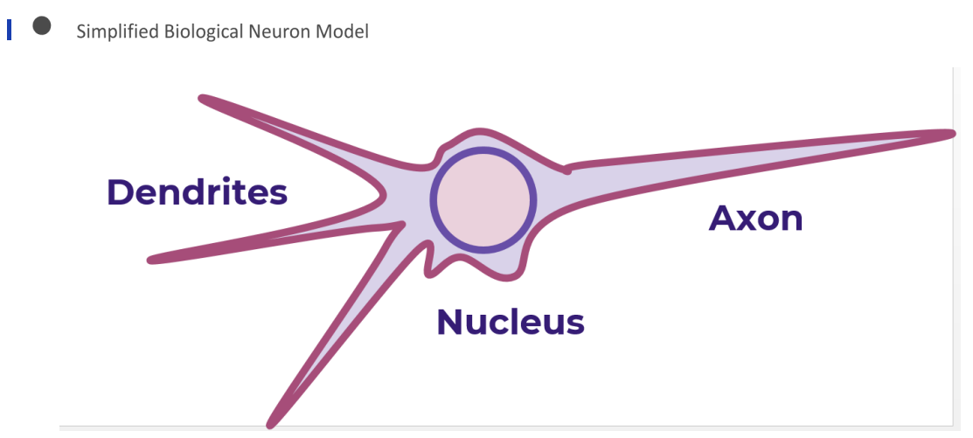
Artificial neural networks (ANN).
As we said before DL is just a way to mimic our human brains.
And this pic is a simplified version of biological neuron and based on it we build our neural networks models.
When we use more than one or two neurons we named it as a deep neural networks, thus the name DL came from.

Slide 6
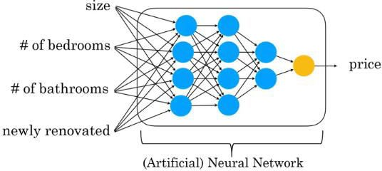
Deep Learning Example

Slide 7
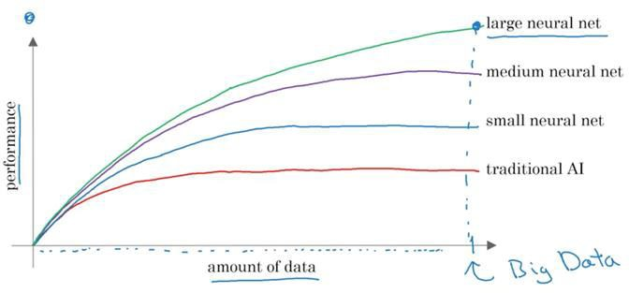
Why it’s needed over ML

Slide 8
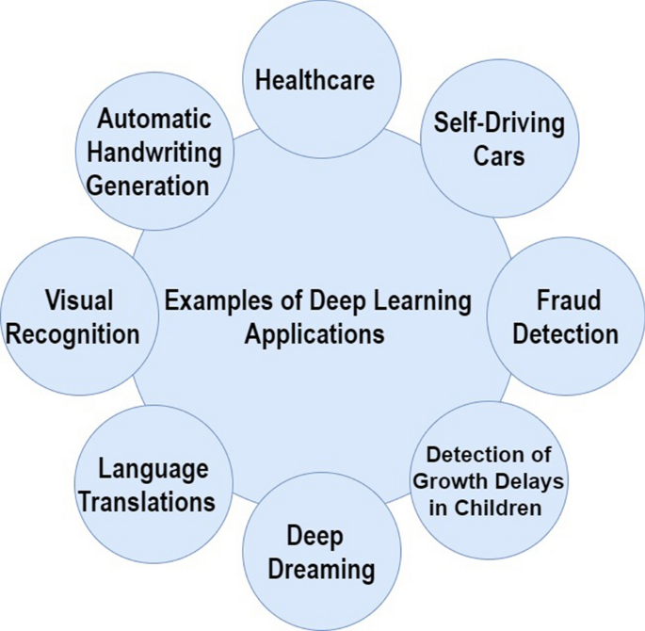
DL Applications
Notes:
https://www.mygreatlearning.com/blog/deep-learning-applications/

Slide 9
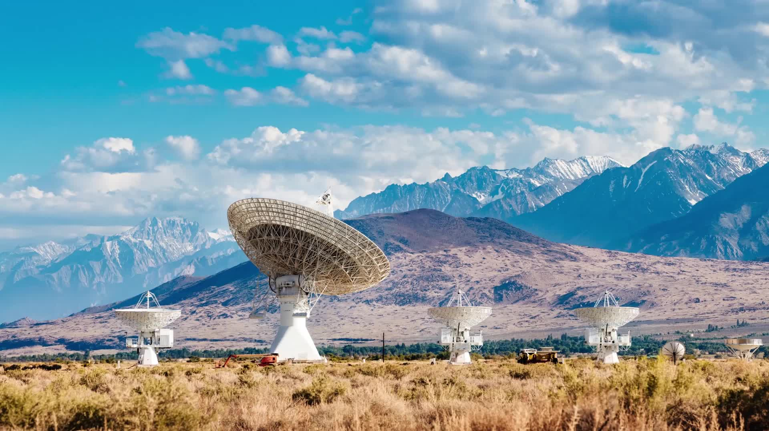
AI And Related Disciplines let's draw it.

Slide 10
Let's fill out this form

Slide 11

Reinforcement Learning (RL)
How do we pet our dogs/cats?, What do you do to give it a reward or punish it?
Reinforcement learning is a machine learning training method based on rewarding desired behaviors and/or punishing undesired ones.
In general, a reinforcement learning is an agent able to perceive and interpret its environment, take actions and learn through trial and error.
Developers devise a method of rewarding desired behaviors and punishing negative behaviors (Maze Example).
So, in short RL agents' goals are to maximize the reward it achieves.
Notes:
https://www.techtarget.com/searchenterpriseai/definition/reinforcement-learning

Slide 12
Let's watch this video ☺

Slide 13
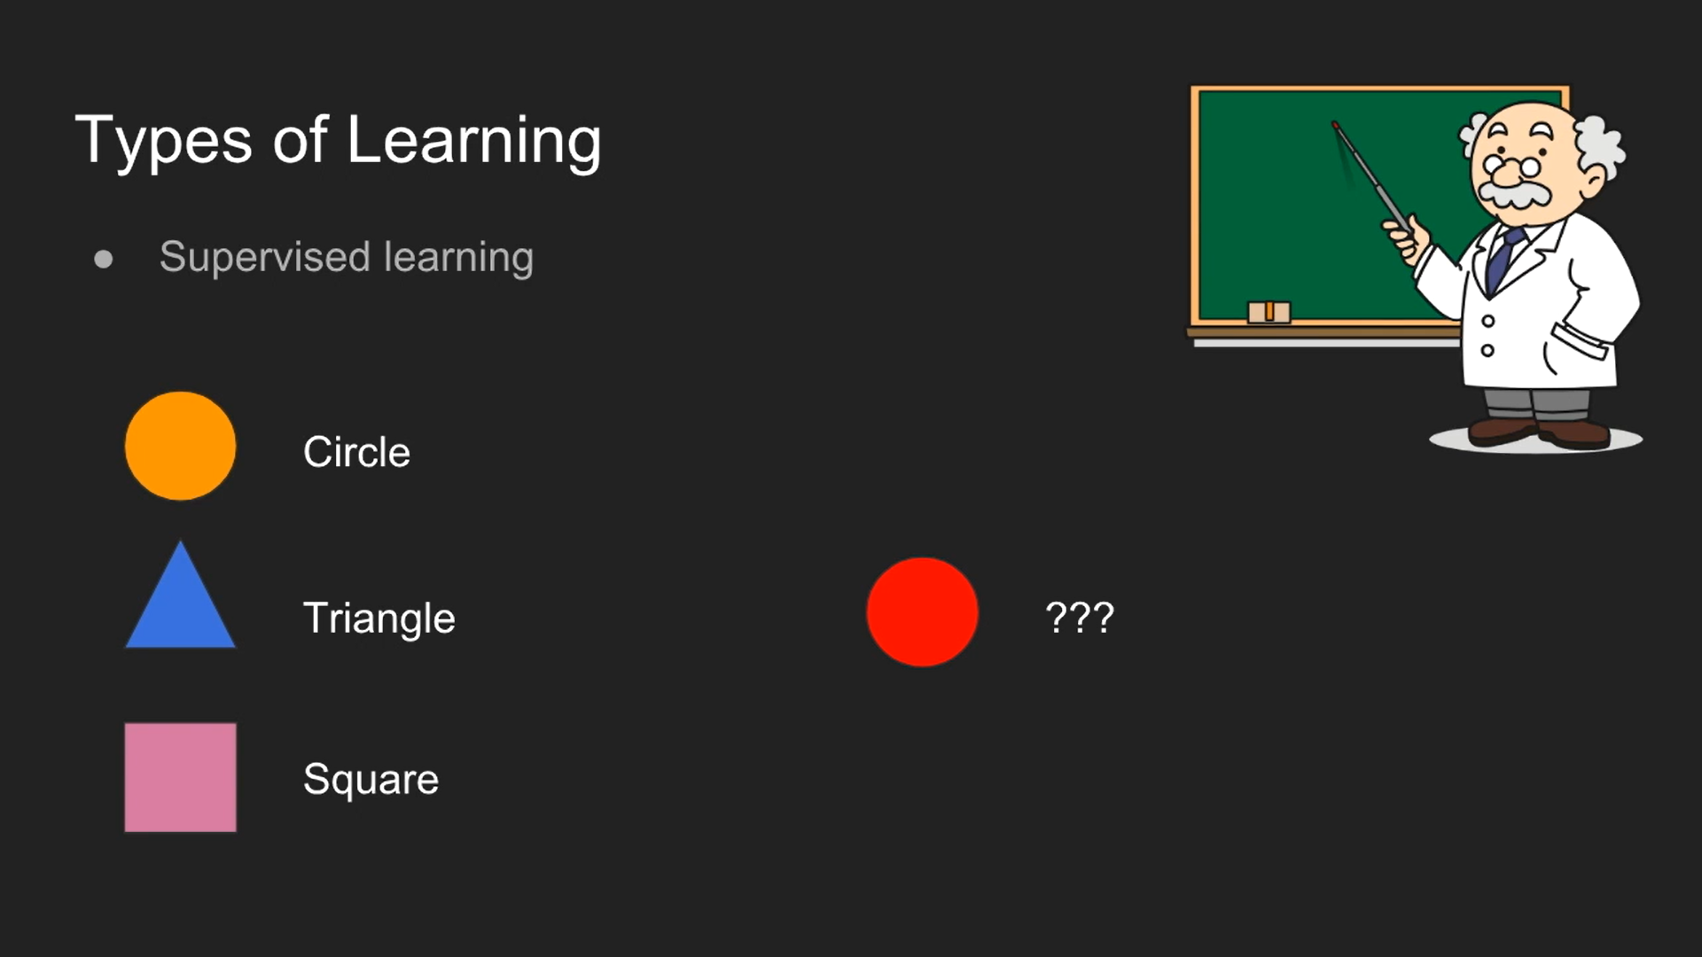
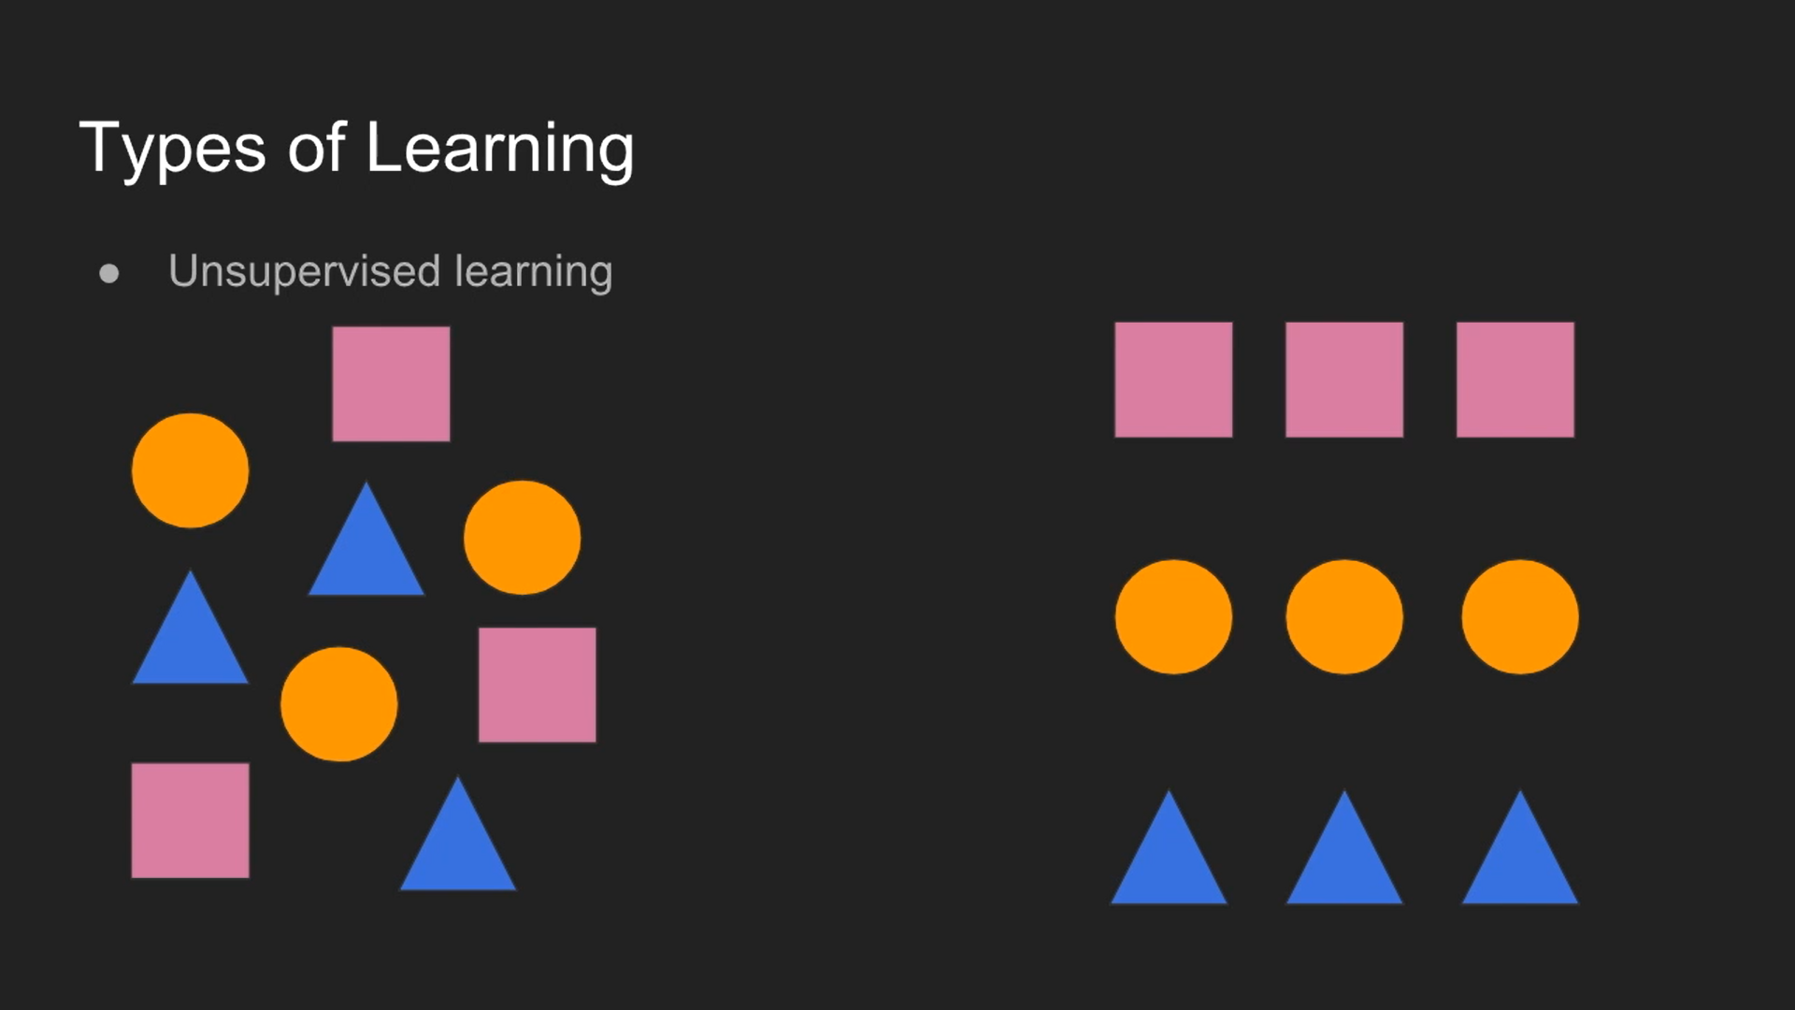
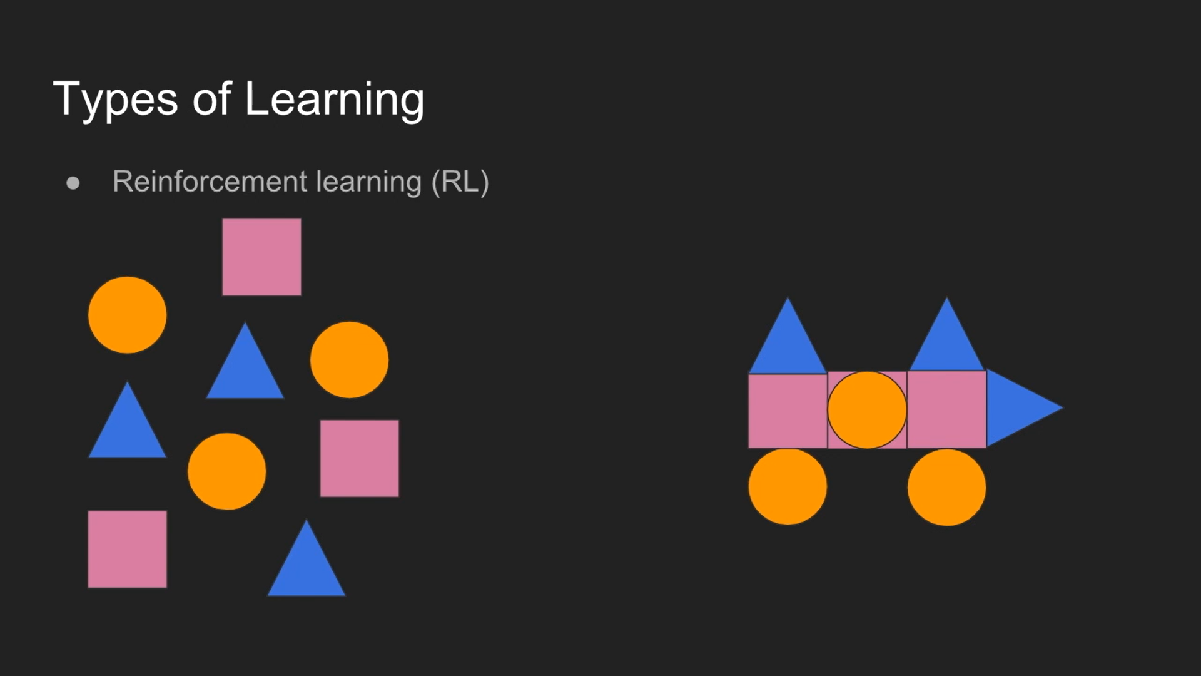
Main ML Types, And Differences

Slide 14
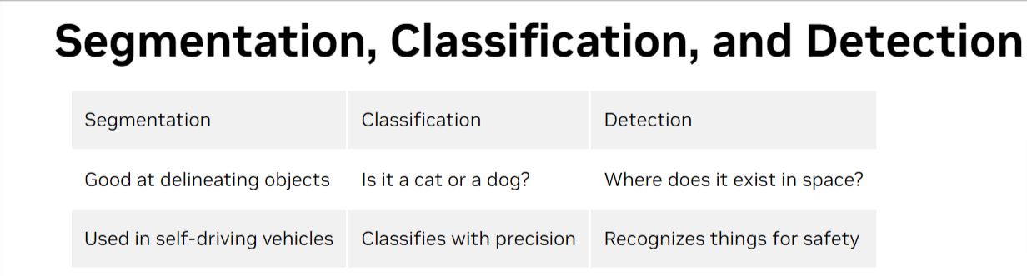
Computer Vision (CV)
Computer vision defines the field that enables devices to acquire, process, understand, and analyze digital images and videos and extract useful information.
CV is as sub-field of deep learning, and most of the models we will use in this part as we will see is deep neural networks called CNN.
CNN is just mimic the way humans recognize things or our visual cortex mechanism.
Main tasks:
Notes:
https://www.nvidia.com/en-us/glossary/data-science/computer-vision/

Slide 15
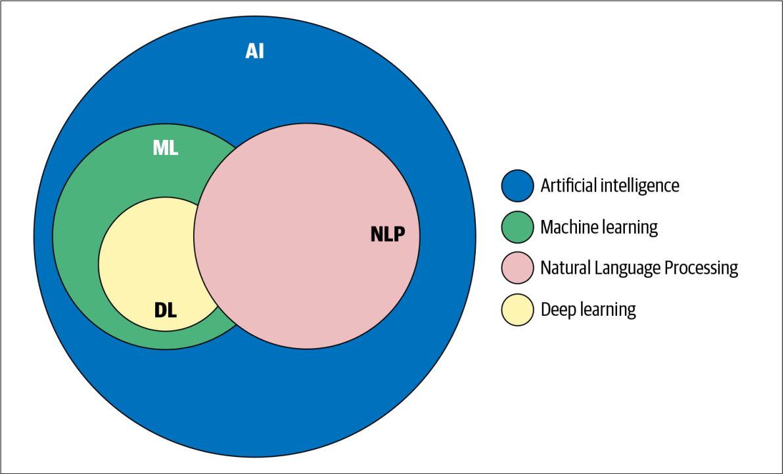
Natural Language Processing (NLP)
How machines process and understand human language?
In theory, we can understand and even predict human behaviors using that info we get from text.
So, NLP is a field of Artificial Intelligence that gives the machines the ability to read, understand and derive meaning from human languages.
And for you as a data scientist you will need NLP more than CV most of the time.
Notes:
Your Guide to Natural Language Processing (NLP) | by Diego Lopez Yse | Towards Data Science

Slide 16
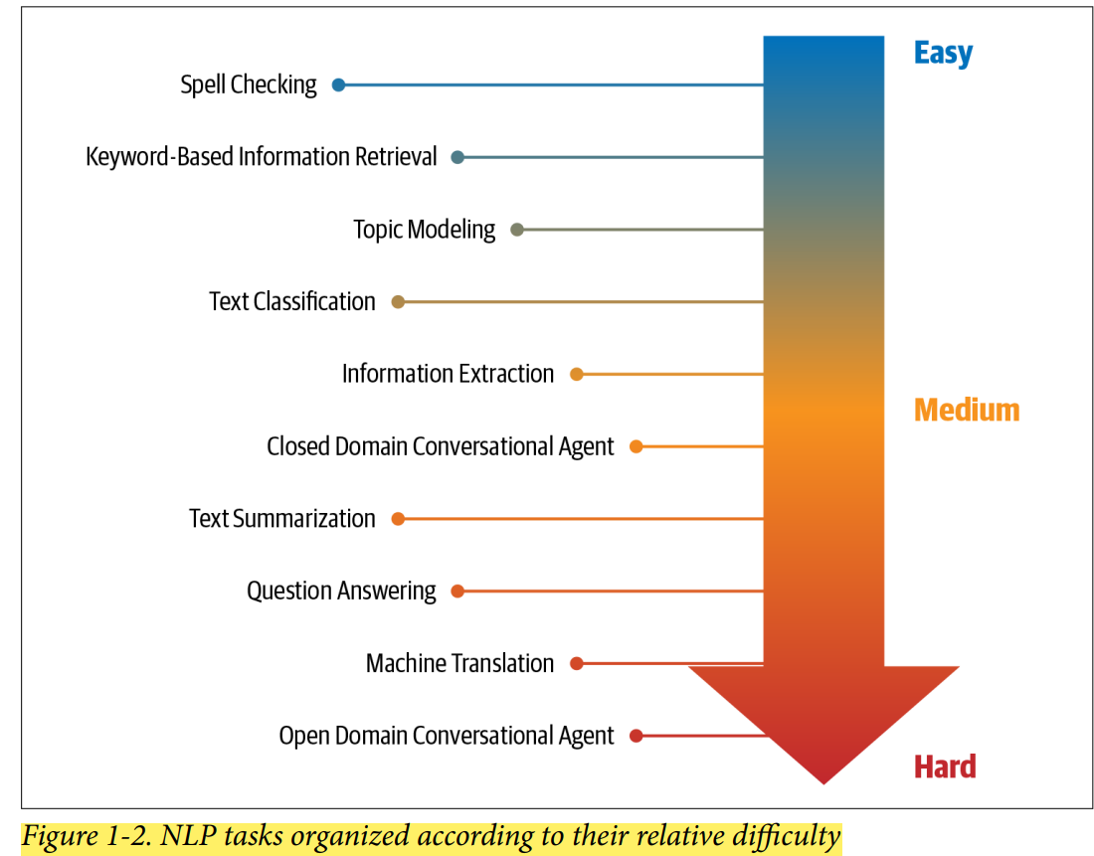

Slide 17
Why NLP Is Challenging?
What makes NLP a challenging problem domain? The ambiguity and creativity of human language.
Ambiguity: means uncertainty of meaning. Most human languages are inherently ambiguous. Consider the following sentence: “I made her duck.”. The first one is: I cooked a duck for her. The second meaning is: I made her bend down to avoid an object ☺.
Creativity: Poems are a great example of creativity in language. Making machines understand creativity is a hard problem not just in NLP, but in AI in general.
So, NLP is really fluctuating filed and scientist really infested about it, and for you as DS you will find how its important for you in practice.

Slide 18
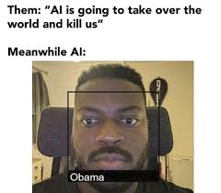
ML Drawbacks
Notes:
https://towardsdatascience.com/advantages-and-disadvantages-of-artificial-intelligence-182a5ef6588c

Slide 19
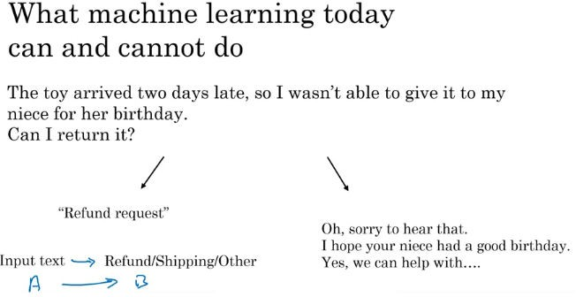
Customer Services Model
Making machines understand creativity is a hard problem in AI in general

Slide 20
Examples of what ML can and can’t do?
Identifying the intent of the customer - Possible
Writing an emphatic response to customer’s email – Not possible or difficult

Slide 21
X-ray diagnosis
Diagnosing a disease from X-ray images– possible
1
Diagnosing a disease after reading a book- difficult or almost impossible.
2

Slide 22
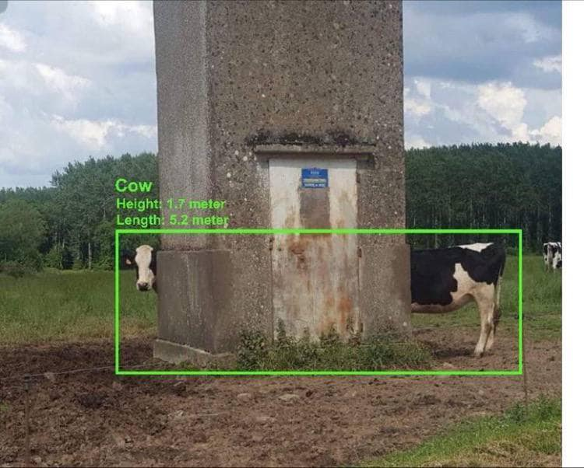
Strengths and weakness of ML
Works when,
Learning a simple concept.
Lots of data available.
Doesn’t work when,
Learning a complex concept (as we see in the last examples).
Asked to work on new type of data such as X-ray images in different conditions and angles.

Slide 23
Please, fill out this Survey

Slide 24
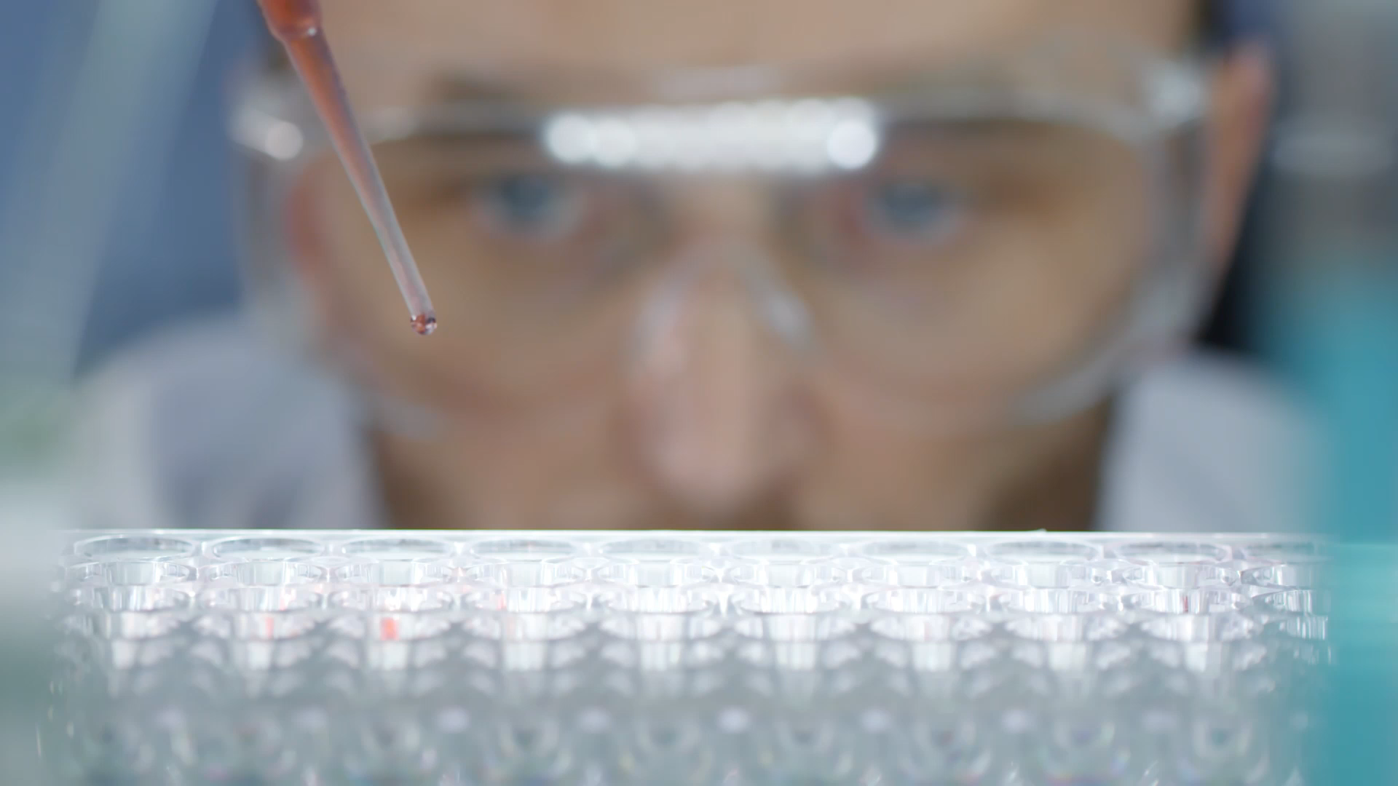
What makes you a good data scientist?

Slide 25
Two types of skills you need:
Tools Skills.
Core Skills.
For tools (technical) skills: here is the practical part come in, you need to learn the main tools you will use like:
Python/R as a programming language and its DS modules e.g. (numpy, pandas and matplotlib) in py and how to use them in DS projects flow.
ML or/and NLP.
SQL: to be able to query your data from database for instance.
Excel (Foundations and main formulas).
Power BI/Tableau for data VIZs.
Math (Mainly probability and statistics).
This is the main tools/technical skills will be required from you as a junior data scientist at most.
Notes:
https://www.simplilearn.com/what-skills-do-i-need-to-become-a-data-scientist-article

Slide 26
The Core Skills Is Really Make A Unique DS.
Mastering this tools in the previous slides is important, but to have this core skills is the beautiful part to be a data scientist.
So, what is this skills about?
Business Understanding
Analytical Thinking
Communication
We can see about it, it’s the way or the mindset you have in work.
And much more tips we will talk about later.
Notes:
https://youtu.be/89amFKwlb0M

Slide 27


